Slide 1


Github Assignment
Presented By : Anshita Mathur

Slide 2
Agenda
Learned about git and different commands (PUSH, PULL, RESET, FETCH, COMMIT etc.)
Introduction
Create and Collaborate on a New Repository
RESET
References

Slide 3

Introduction
Git is the most commonly used version control system. Git tracks the changes you make to files, so you have a record of what has been done, and you can revert to specific versions should you ever need to. Git also makes collaboration easier, allowing changes by multiple people to all be merged into one source.
So regardless of whether you write code that only you will see, or work as part of a team, Git will be useful for you. Git lets you branch out from the original code base. This lets you more easily work with other developers, and gives you a lot of flexibility in your workflow.

Slide 4
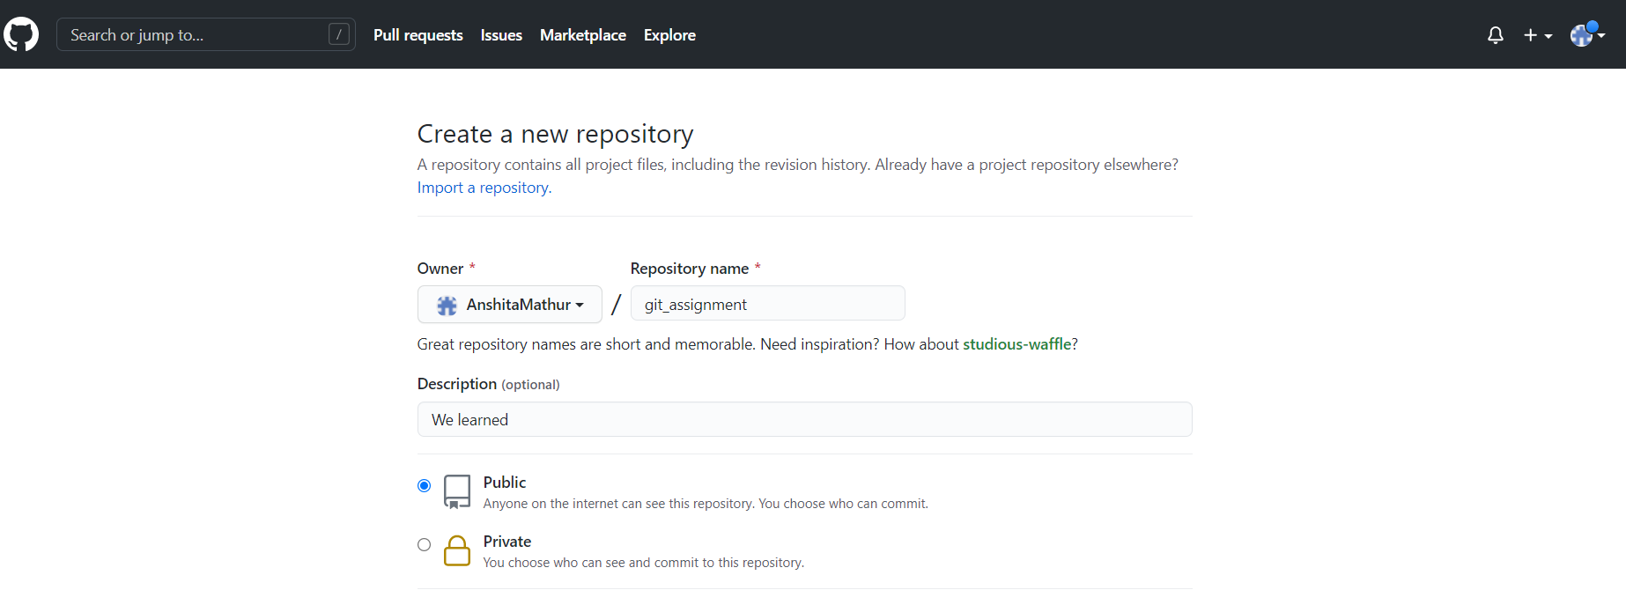
Create and Collaborate on New Repository
To put your project up on GitHub, you'll need to create a repository for it to live in.

Slide 5
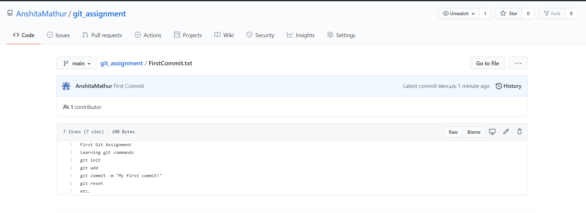

Commit
After creating new repository, commit new file.
3,967
518
12,057
9,381
OUR CLIENTS
PROJECTS RUNNING
FOLLOWERS
LIKES
Sutiable for any kind presentation
Sutiable for any kind presentation
Sutiable for any kind presentation
Sutiable for any kind presentation

Slide 6


Reset
git-reset - Reset current HEAD to the specified state
The git reset command is a complex and versatile tool for undoing changes. It has three primary forms of invocation.
These forms correspond to command line arguments --soft, --mixed, --hard. The three arguments each correspond to Git's three internal state management mechanism's, The Commit Tree (HEAD), The Staging Index, and The Working Directory.
The best way to demonstrate these mechanisms is to create a changeset in a repository and follow it through the three trees.

Slide 7
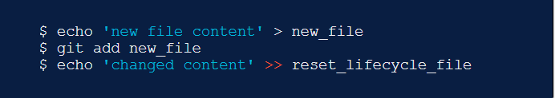

git reset
At a surface level, git reset is similar in behavior to git checkout. Where git checkout solely operates on the HEAD ref pointer, git reset will move the HEAD ref pointer and the current branch ref pointer.
git reset is a powerful command that is used to undo local changes to the state of a Git repo.

Slide 8
References
github.com
edureka.co
atlassian.com
youtube.com/c/beaprogrammer

Slide 9

Thank You!

